Slide 1
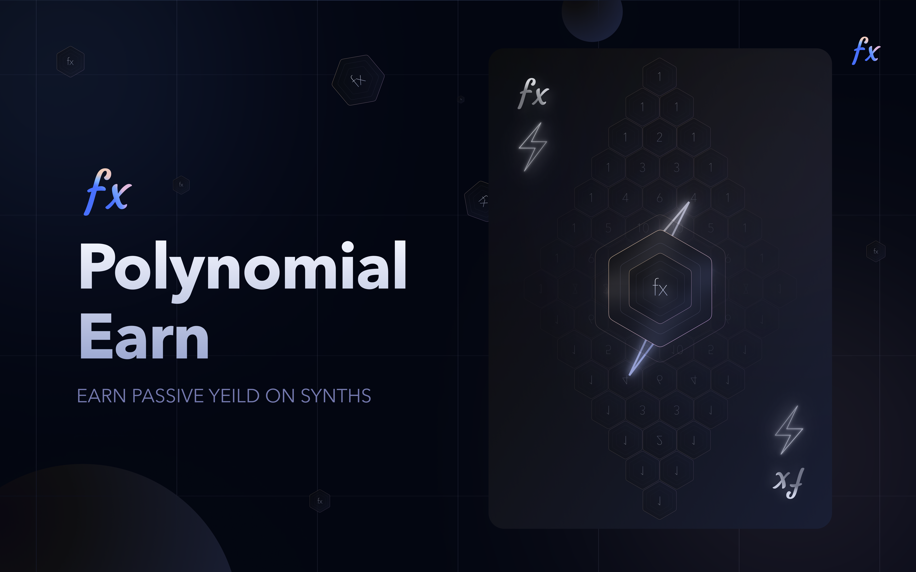

Slide 2
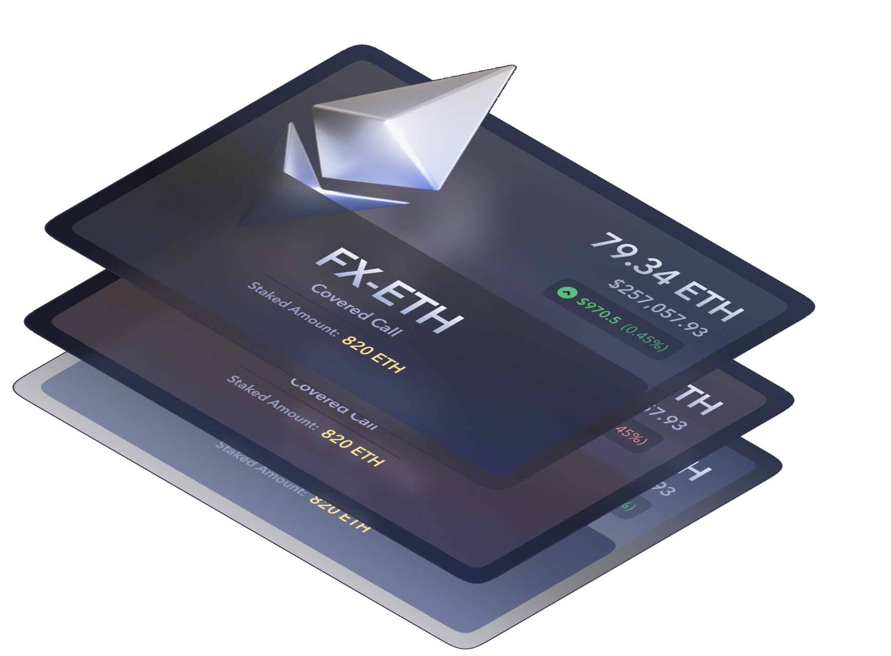
🤔 why
User’s don’t have great way to earn yield on Optimism

Slide 3
💸
Polynomial makes option selling easy for everyone

Slide 4
Option Vaults
👇
Market Makers

Slide 5
Option Vaults
❓
On Chain (AMM)

Slide 6
Option Vaults
Polynomial Earn
On Chain (AMM)

Slide 7
🚀 The first DeFi Options Vault (DOV) to execute on-chain via an AMM.
⚡️ All with the speed and cheap transactions powered by Optimism.

Slide 8
ETH 3500 Call at 31st Apr 2022
Premium 50 ~ Fees
ETH ~ 3000

Slide 9
If ETH > 3550 ~ loss
If ETH < 3550 ~ profit

Slide 10
Demo

Slide 11
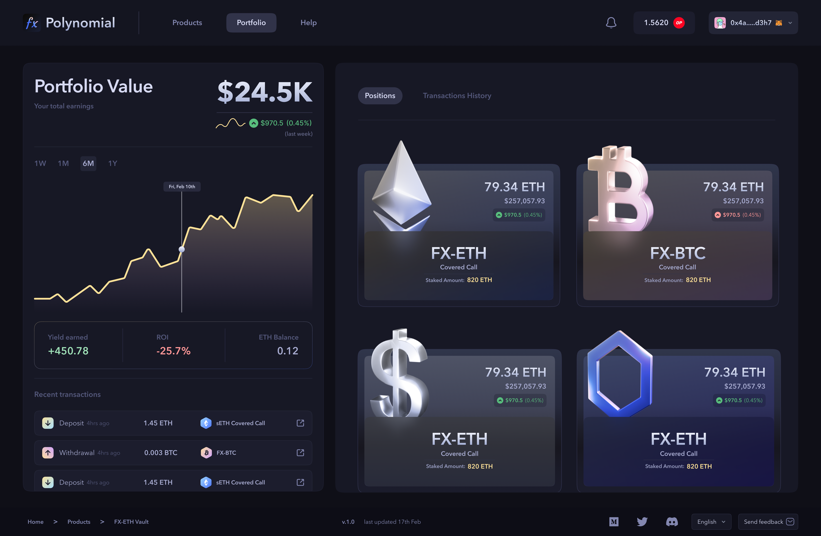

Slide 12
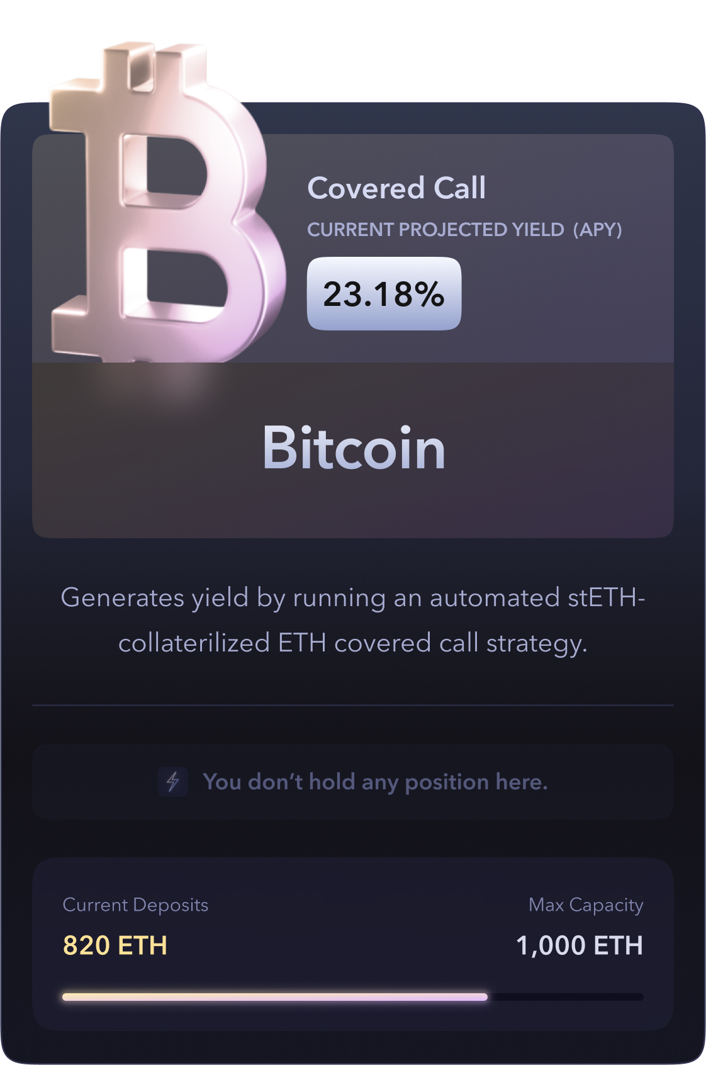
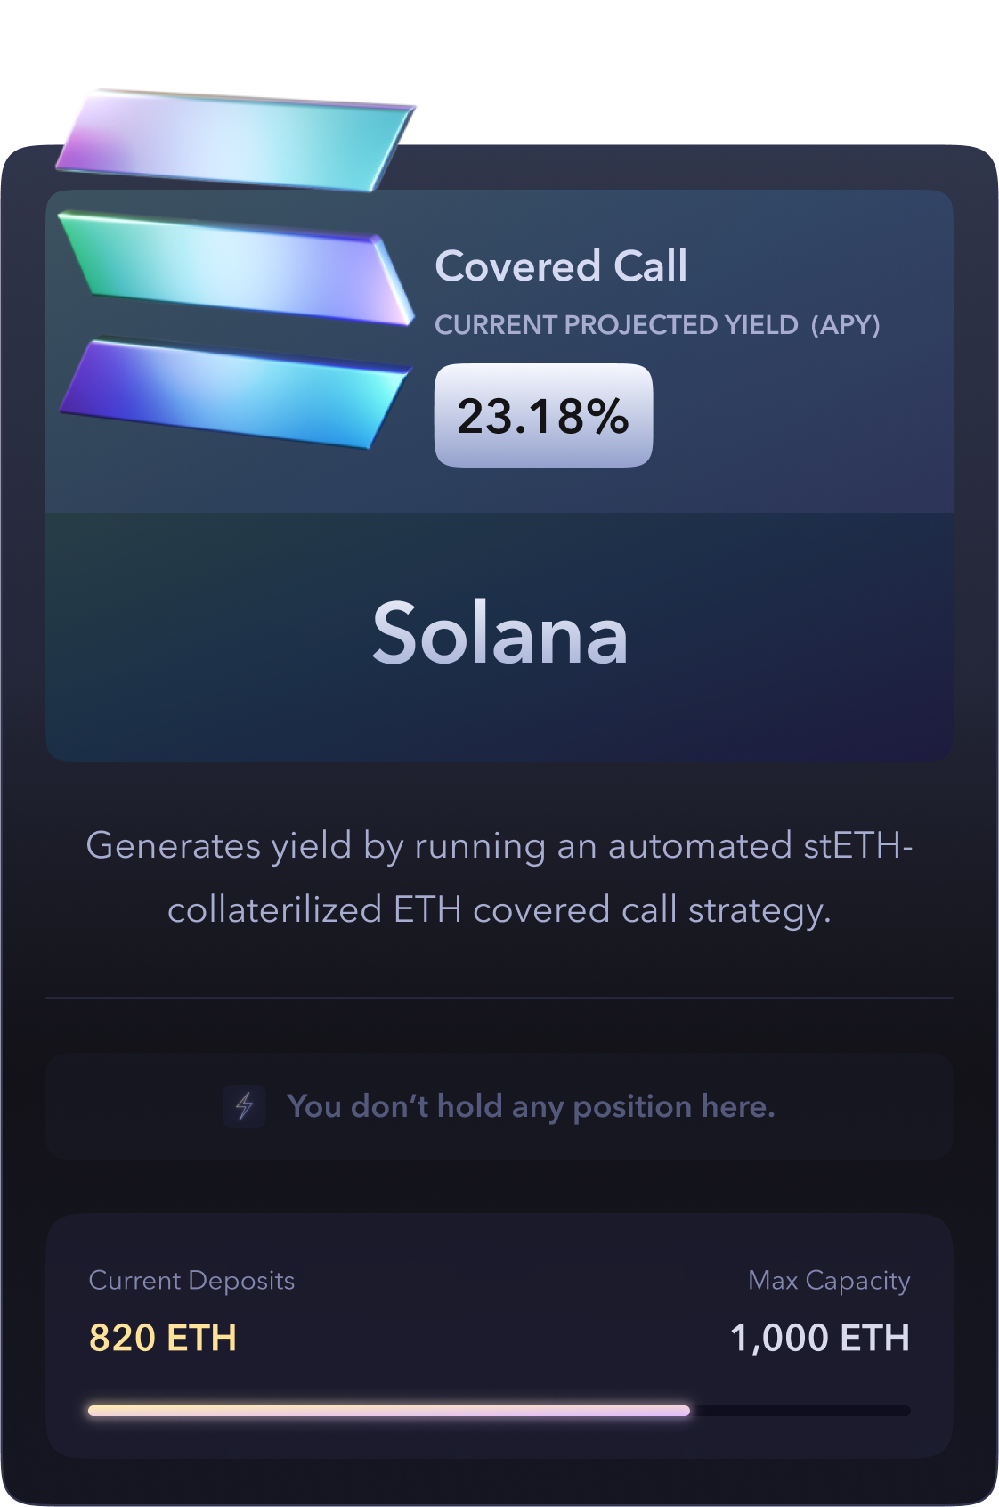
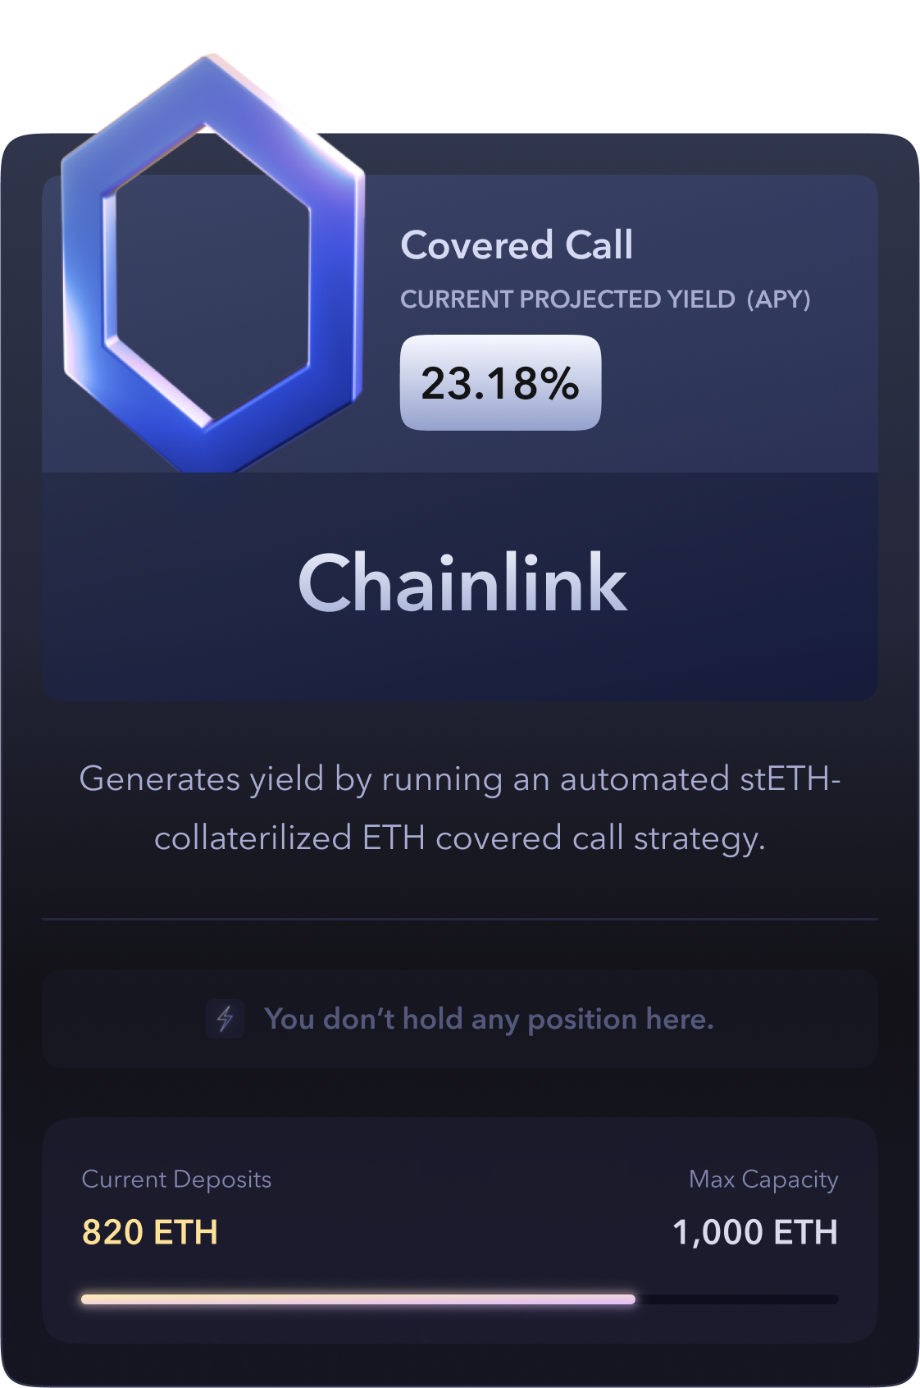
💪 Increased Cap and More Vaults

Slide 13
🙌 Partially collateralised Vaults ~ Higher APY
80% collateralised ETH selling w/ Lyra Avalon.

Slide 14


✨ Newer Option Vaults
🤝 Combing perps and options

Slide 15
🤔 Questions?

